Slide 1
Designing the Low-Power M•CORE™ Architecture
Jeff Scott, Lea Hwang Lee, John Arends, Bill Moyer
Motorola Inc.
Presented by Lim, Sung-taek

Slide 2
Contents
1. Introduction
2. Benchmarks
3. Instruction Set Architecture
4. Processor Implementation
5. Power Measurement
6. System Solutions
7. Conclusion

Slide 3
Introduction
Previous approaches to reduce power consumption
  new architectures [22, 23]
  derivatives of existing architectures [1, 15]
  compiler and compression optimizations [16, 17]
  enhanced process technology [10]
  new design tools & technologies [11, 5, 7, 14]
M•CORE
  designed from ground up to achieve low power consumption
  compilers were developed simultaneously

Slide 4
Benchmarks
Embedded and portable benchmarks used to make design trade-offs in the architecture and the compiler
  Powerstone benchmark suite

Slide 5
Instruction Set Architecture
Overview
  Integer data types of 8, 16, 32-bit are supported
  Small set of conditionally executed instructions
  HW support for ‘expensive’ operations
  HW support for multiply and divide enhancing real-time control loop performance
16-bit vs. 32-bit
  16-bit fixed length instruction format
  32-bit load/store RISC architecture
Low-Power Instructions
  invoke power conservation modes (DOZE, WAIT, STOP)

Slide 6
Process Implementation
sub-2.0 V operation, 0-40 MHz, 0.36 micron low-leakage static CMOS process
2 mm² die size with synthesizable control logic and full-custom datapath
Reduced power consumption using
  gating clocks
  delayed clocks to minimize glitching
  optimizing clock tree

Slide 7
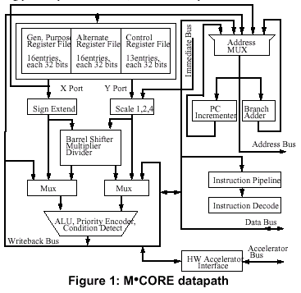
Process Implementation - Datapath Design (1/4)

Slide 8
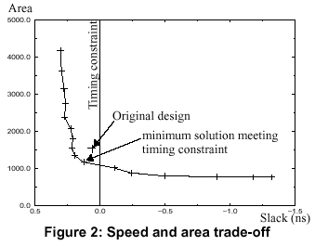
Process Implementation - Datapath Design (2/4)
Synthesizable vs. Custom
  synthesized 32-bit adder compared to custom one
    transistor count increased by 60 %
    area increased by 175 %
    power consumption increased by 40 %
Speed, Area and Power Trade-off
  using FOCUS [8]

Slide 9
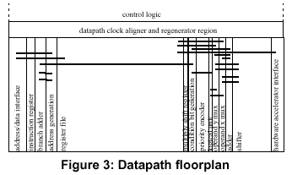
Process Implementation - Datapath Design (3/4)
Floorplanning
  hard constraint : timing
  cost function : switching activities, routing distance, block usage

Slide 10
Process Implementation - Datapath Design (4/4)
Register File Design
  16 general purpose registers
  alternate 16 registers to reduce context switching overhead
  5 supervisor scratch registers in supervisor mode
Barrel Shifter Design
  “Snaked Data” vs. “Snaked Control”

Slide 11
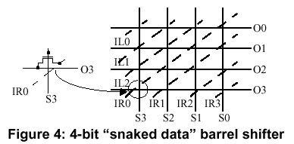
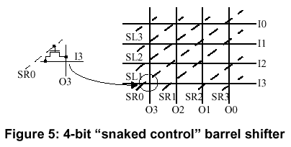
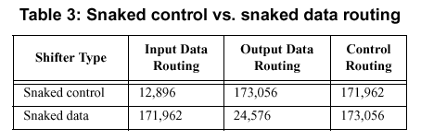

Slide 12
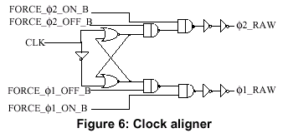
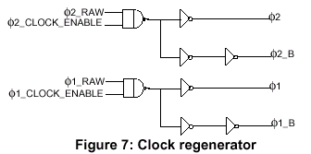
Process Implementation - Clocking System Design
Reducing datapath power consumption
  clock gating
  delayed clocks
Reducing clocking power consumption
  clock aligner
  clock regenerator

Slide 13
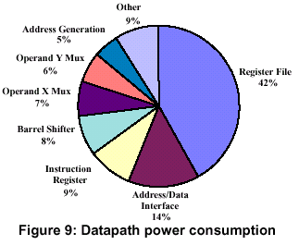
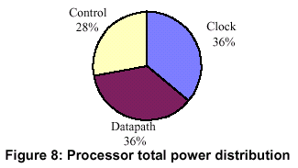
Power Measurement

Slide 14
System Solutions (1/2)
MMC2001
  0.36 micron, triple layer metal, low-leakage static CMOS process
  on-chip memory : 256KB ROM, 32KB SRAM
  34MHz at 1.8V

Slide 15
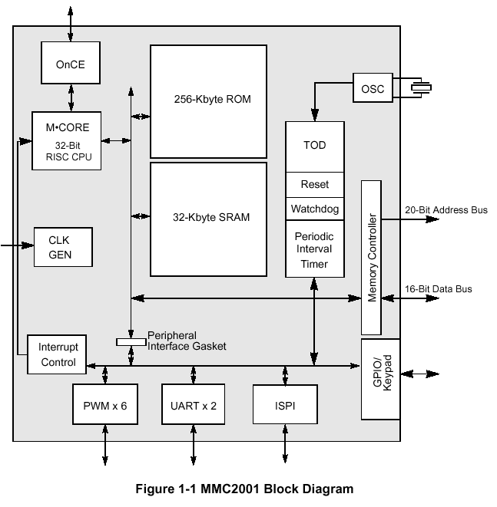

Slide 16
System Solutions (2/2)
MMC56652
  0.31 micron, triple layer metal, static CMOS process
  on-chip memory : 8KB ROM, 2KB SRAM
  16.8MHz at 1.8V
  includes 56600 Onyx Ultra-Lite 16-bit DSP, program and data memory

Slide 17
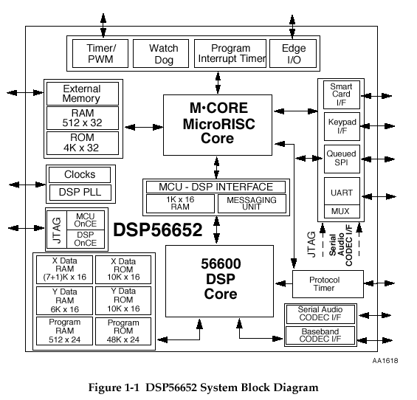

Slide 18
Conclusion
encompassed all levels of abstraction from
  application software
  system solutions
  compiler technologies
  architecture
  circuits
  process optimizations

